Slide 1
GOLDEN & DISTRICT ROTARY CLUB CONFLUENCE PARK TRAIL IMPROVEMENT PROJECT
Golden Proposal
Bob Finnie
Director Community Service

Slide 2
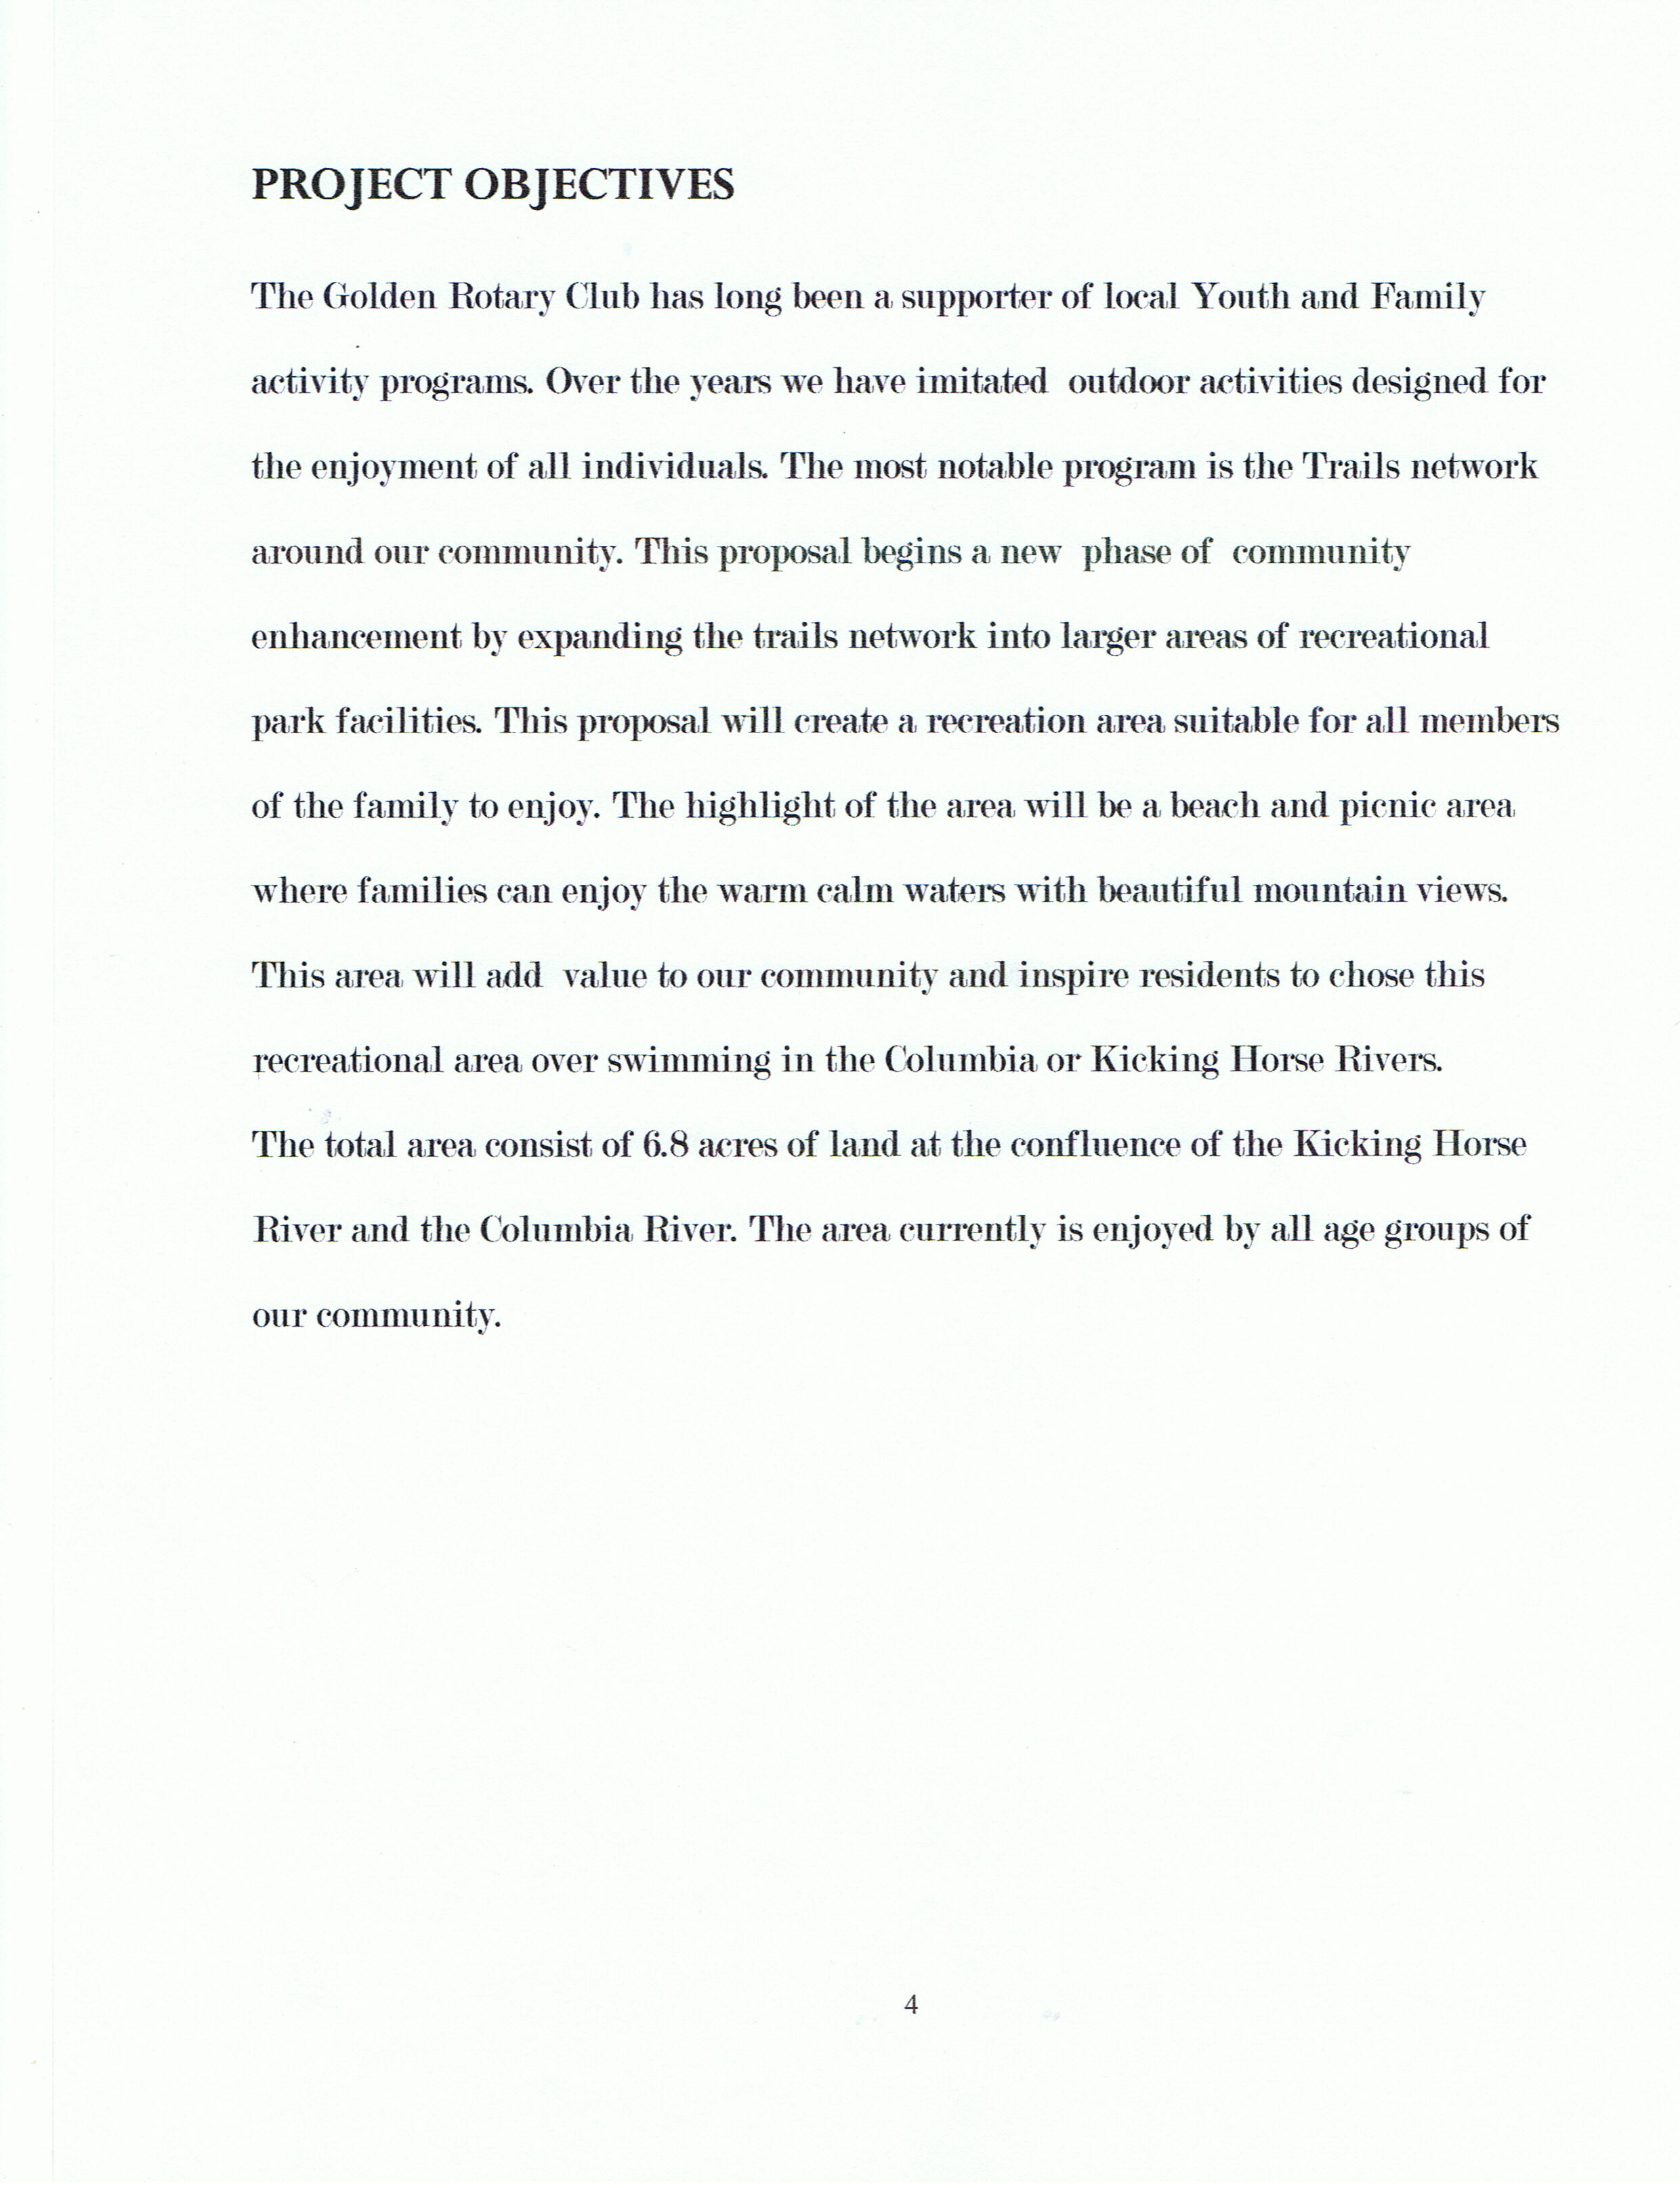
CONFLUENCE PARK TRAIL IMPROVEMENT PROJECT

Slide 3
CONFLUENCE PARK TRAIL IMPROVEMENT PROJECT
Present view of Park Area

Slide 4
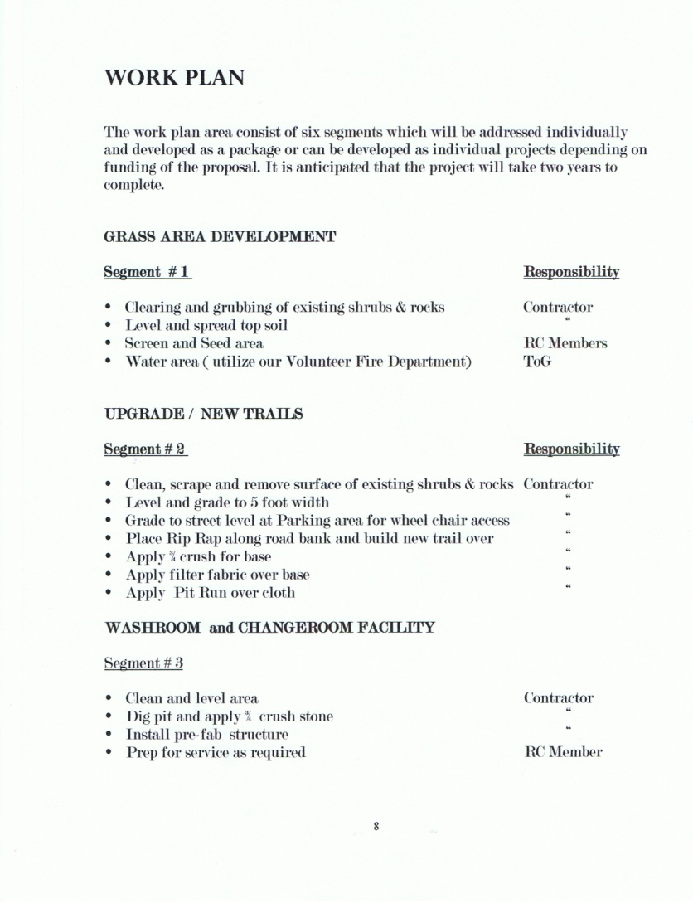
CONFLUENCE PARK TRAIL IMPROVEMENT PROJECT

Slide 5
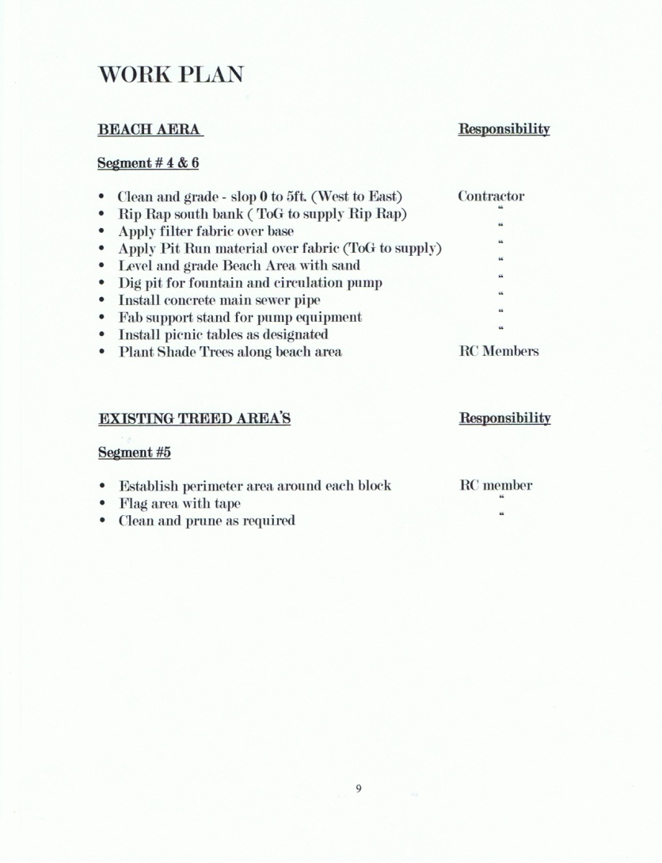
CONFLUENCE PARK TRAIL IMPROVEMENT PROJECT

Slide 6
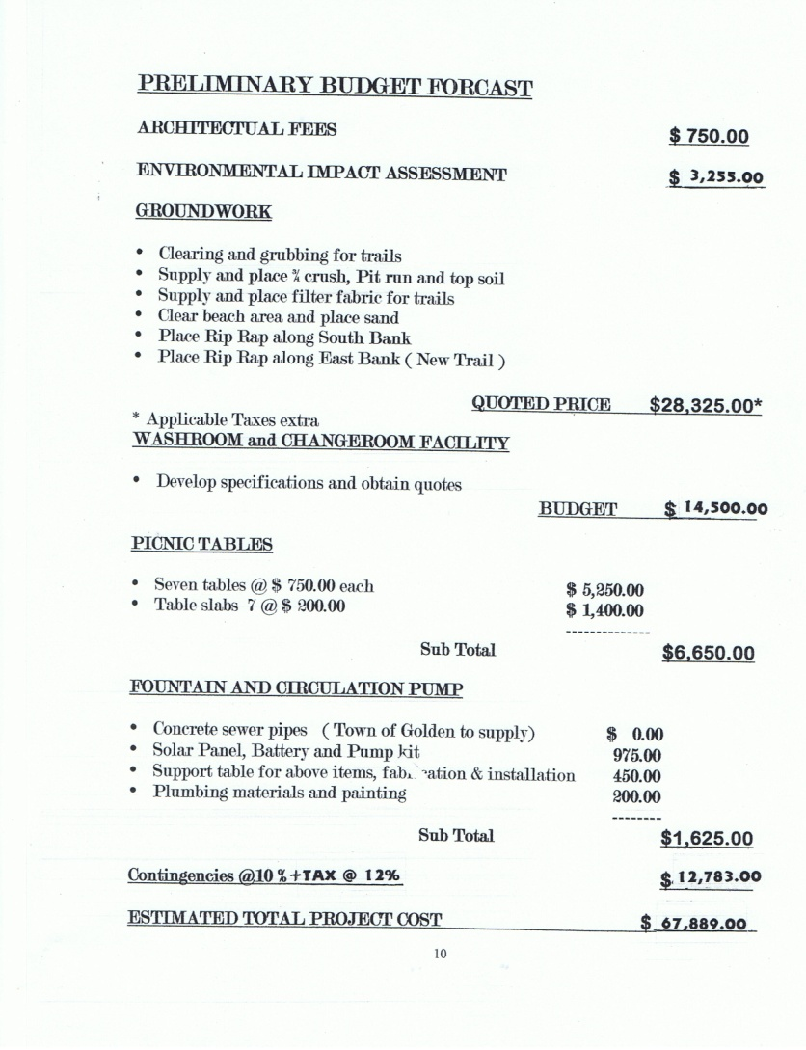
CONFLUENCE PARK TRAIL IMPROVEMENT PROJECT

Slide 7
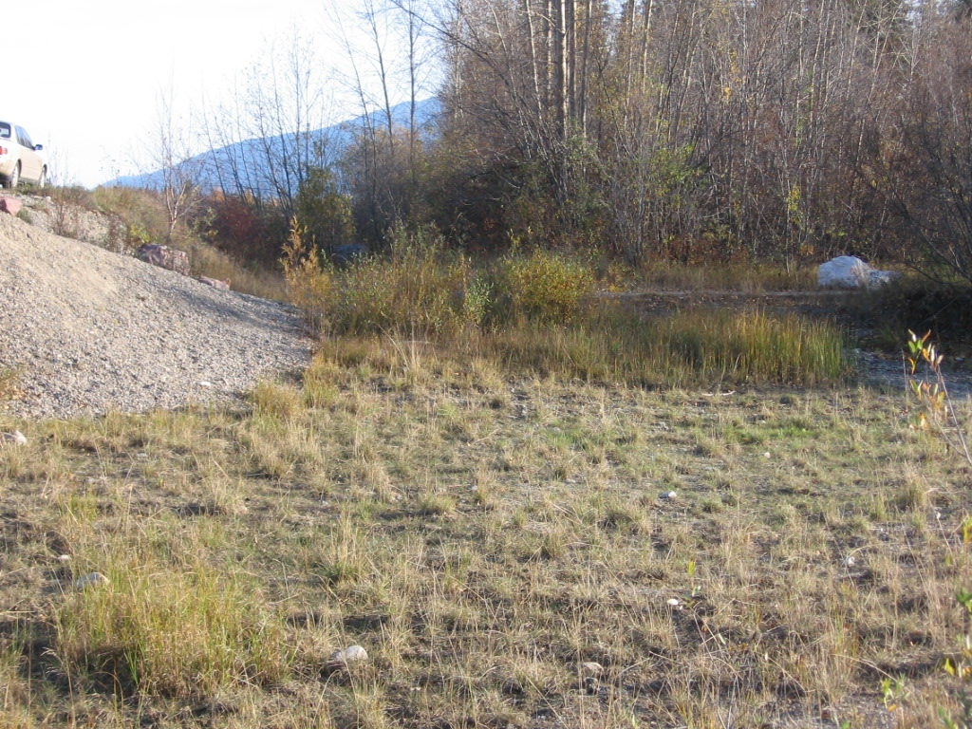
CONFLUENCE PARK TRAIL IMPROVEMENT PROJECT
OVERVIEW PARK AREA
TRAIL CONNECTION TO WEST SIDE OF POND

Slide 8
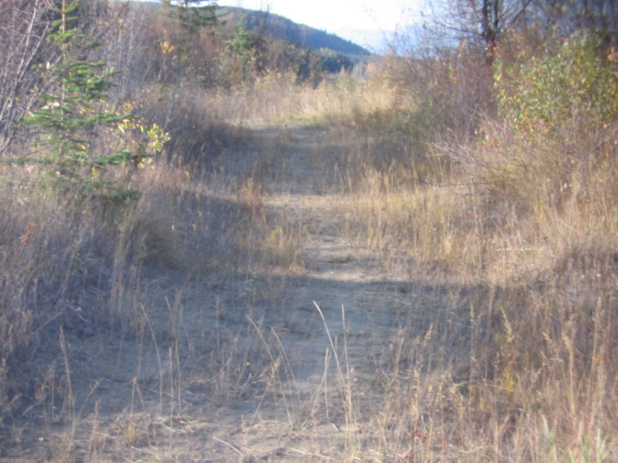
CONFLUENCE PARK TRAIL IMPROVEMENT PROJECT
OVERVIEW PARK AREA
TRAIL CONNECTION TO MAIN GREEN AREA

Slide 9
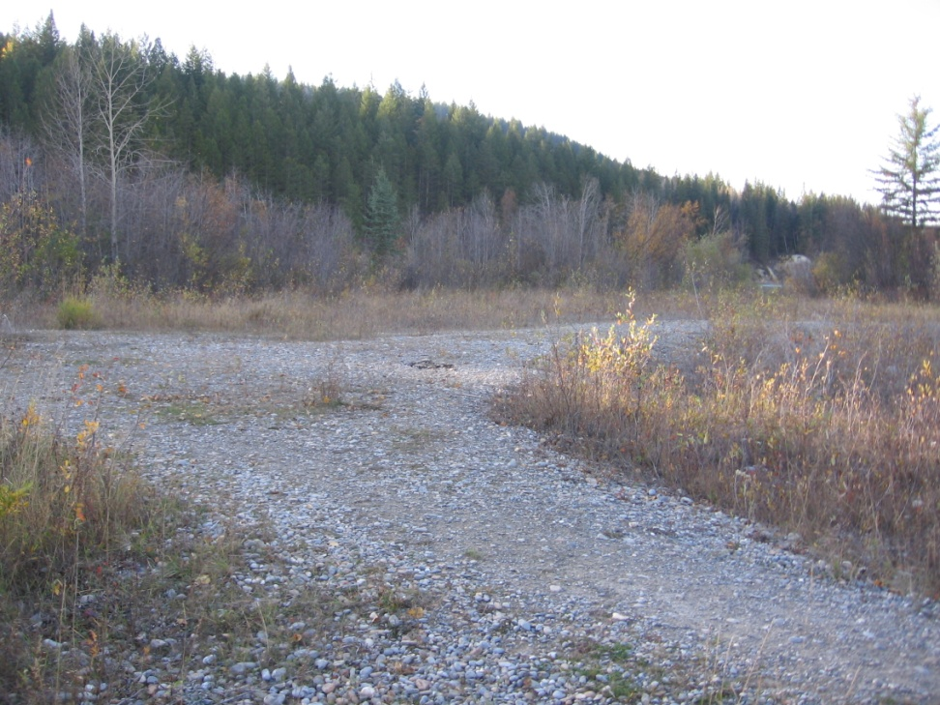
CONFLEUNCE PARK TRAIL IMPROVEMENT PROJECT
OVERVIEW OF PARK AREA
MAIN GREEN PARK AREA

Slide 10
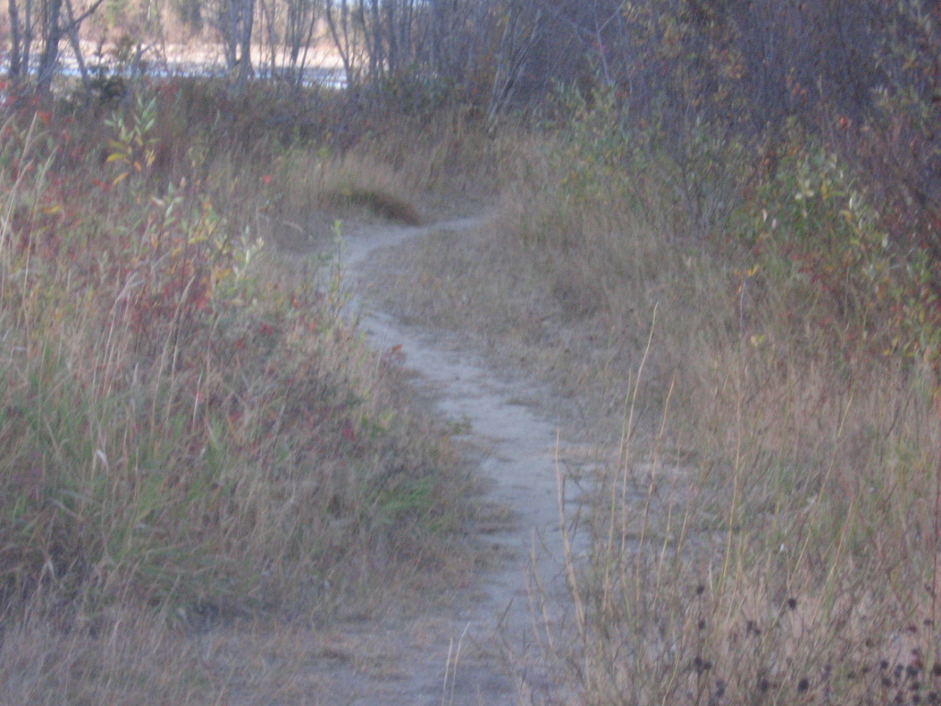
CONFLUENCE PARK TRAIL IMPROVEMENT PROJECT
OVERVIEW PARK AREA
RIVER SIDE TRAIL GREEN AREA TO POND

Slide 11
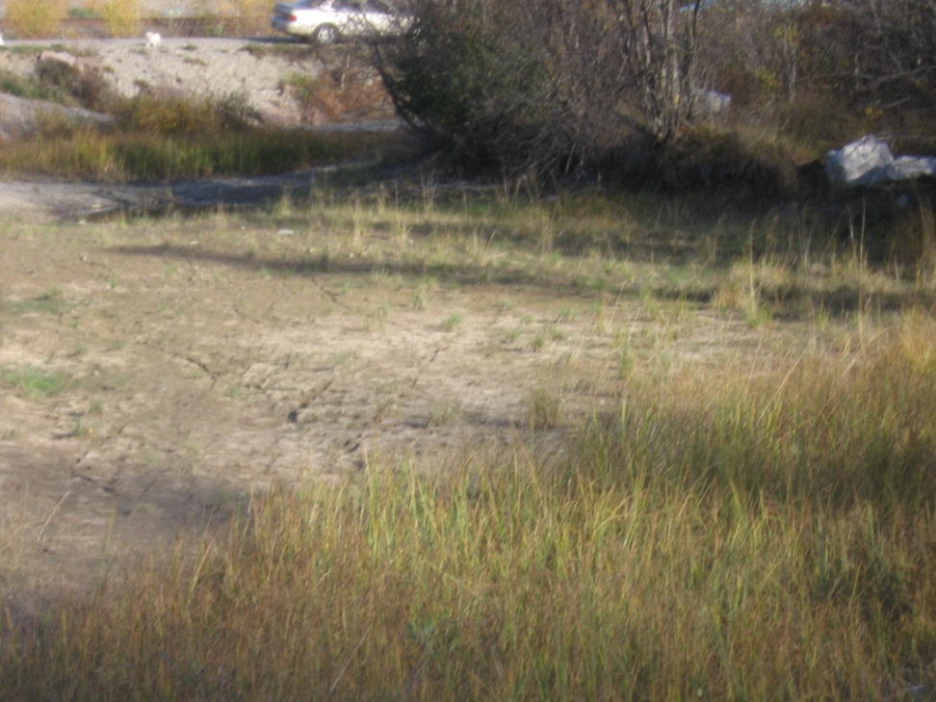
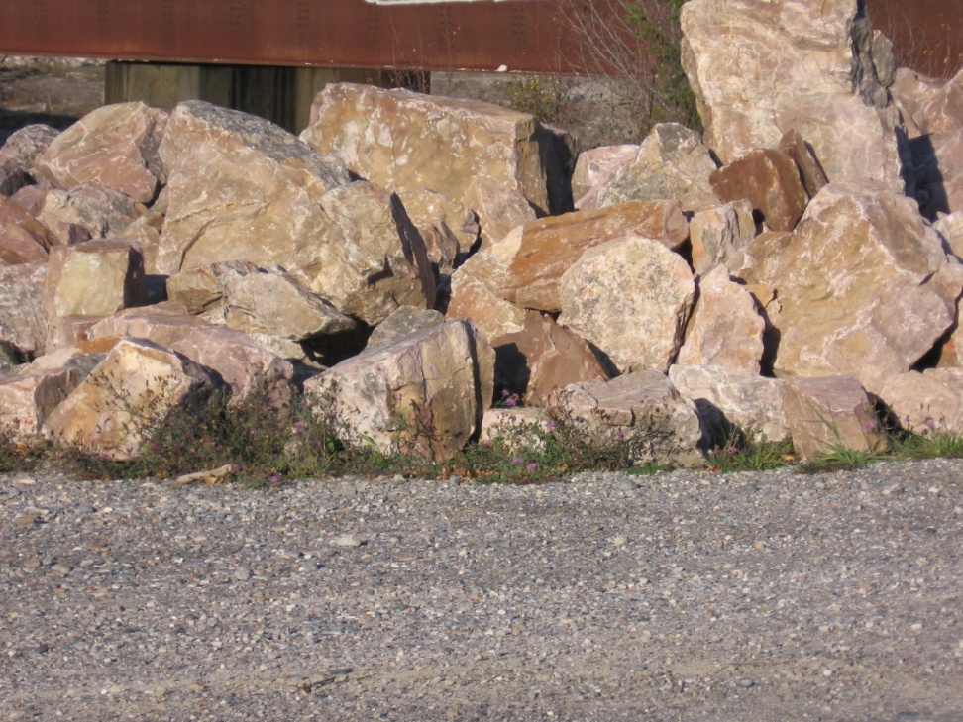
CONFLUENCE PARK TRAIL IMPROVEMENT PROJECT
SOUTH SIDE POND BANK
PROPOSED BANK EROSION CONTROL

Slide 12
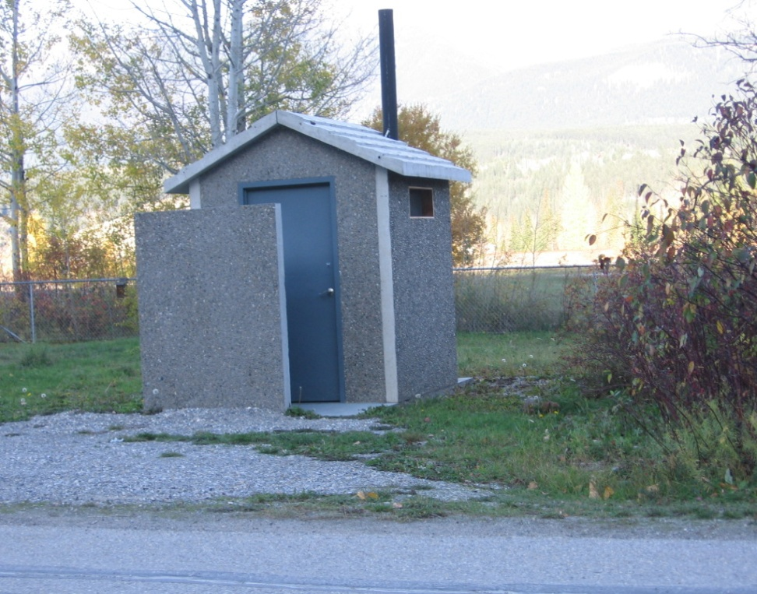
CONFLUENCE PARK TRAIL IMPROVEMENT PROJECT
OVERVIEW PARK AREA
WASHROOM & CHANGE FACILITY

Slide 13
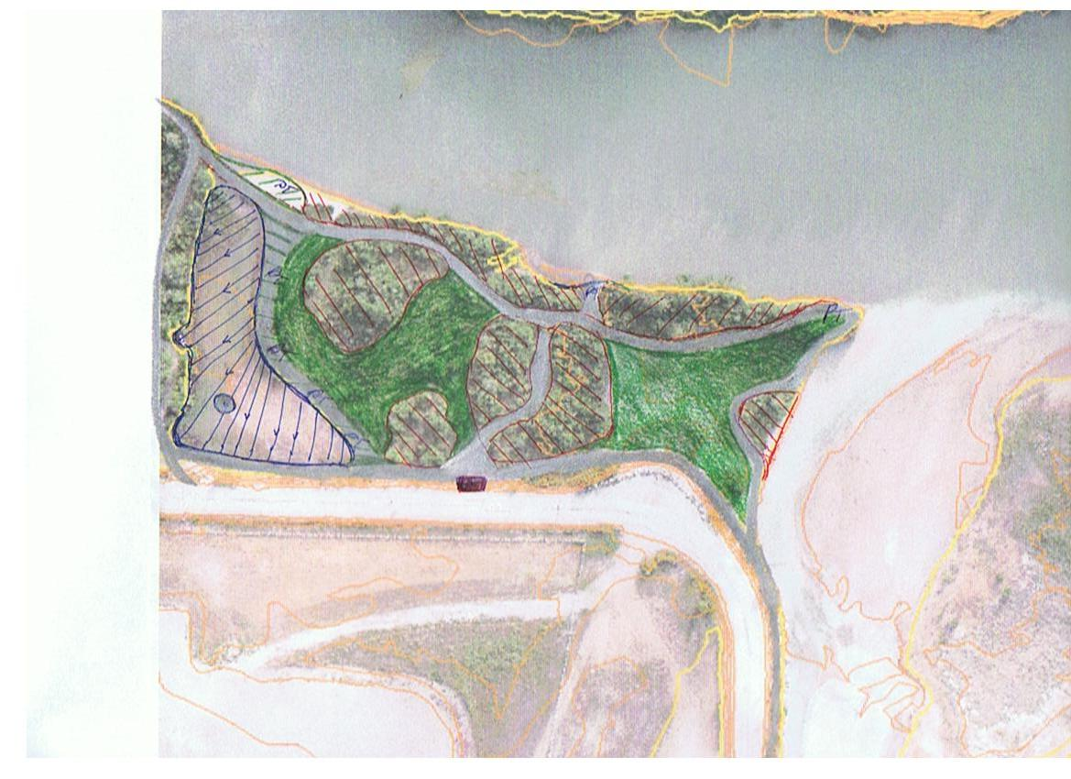
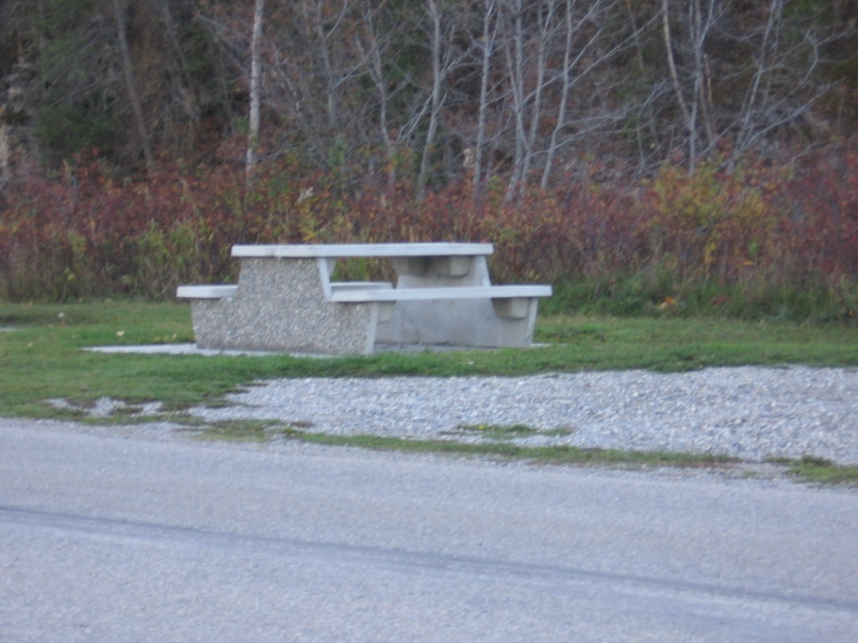
CONFLUENCE PARK TRAIL IMPROVEMENT PROJECT
OVERVIEW PARK AREA
PICNIC TABLES – 7 LOCATIONS

Slide 14
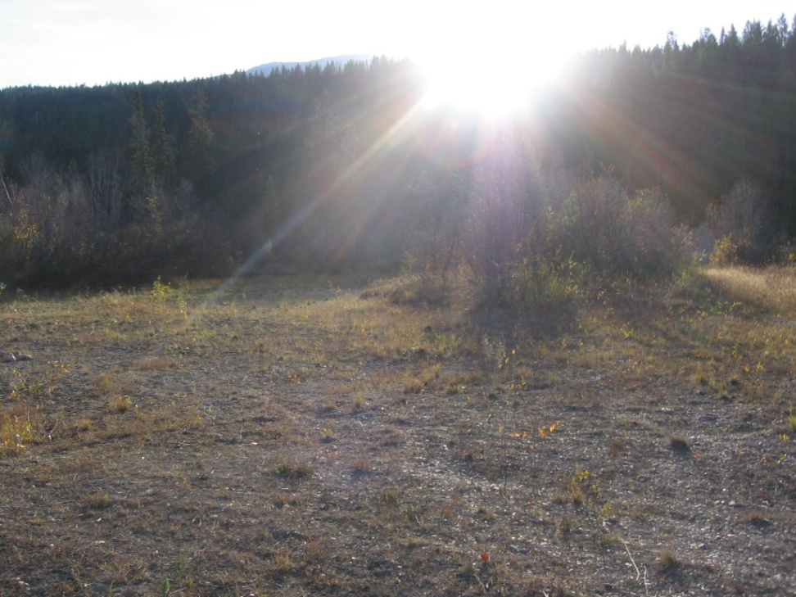
CONFLUENCE PARK TRAILIMPROVEMENT PROJECT
SANDY BEACH LINE
PROPOSED OVERVIEW

Slide 15
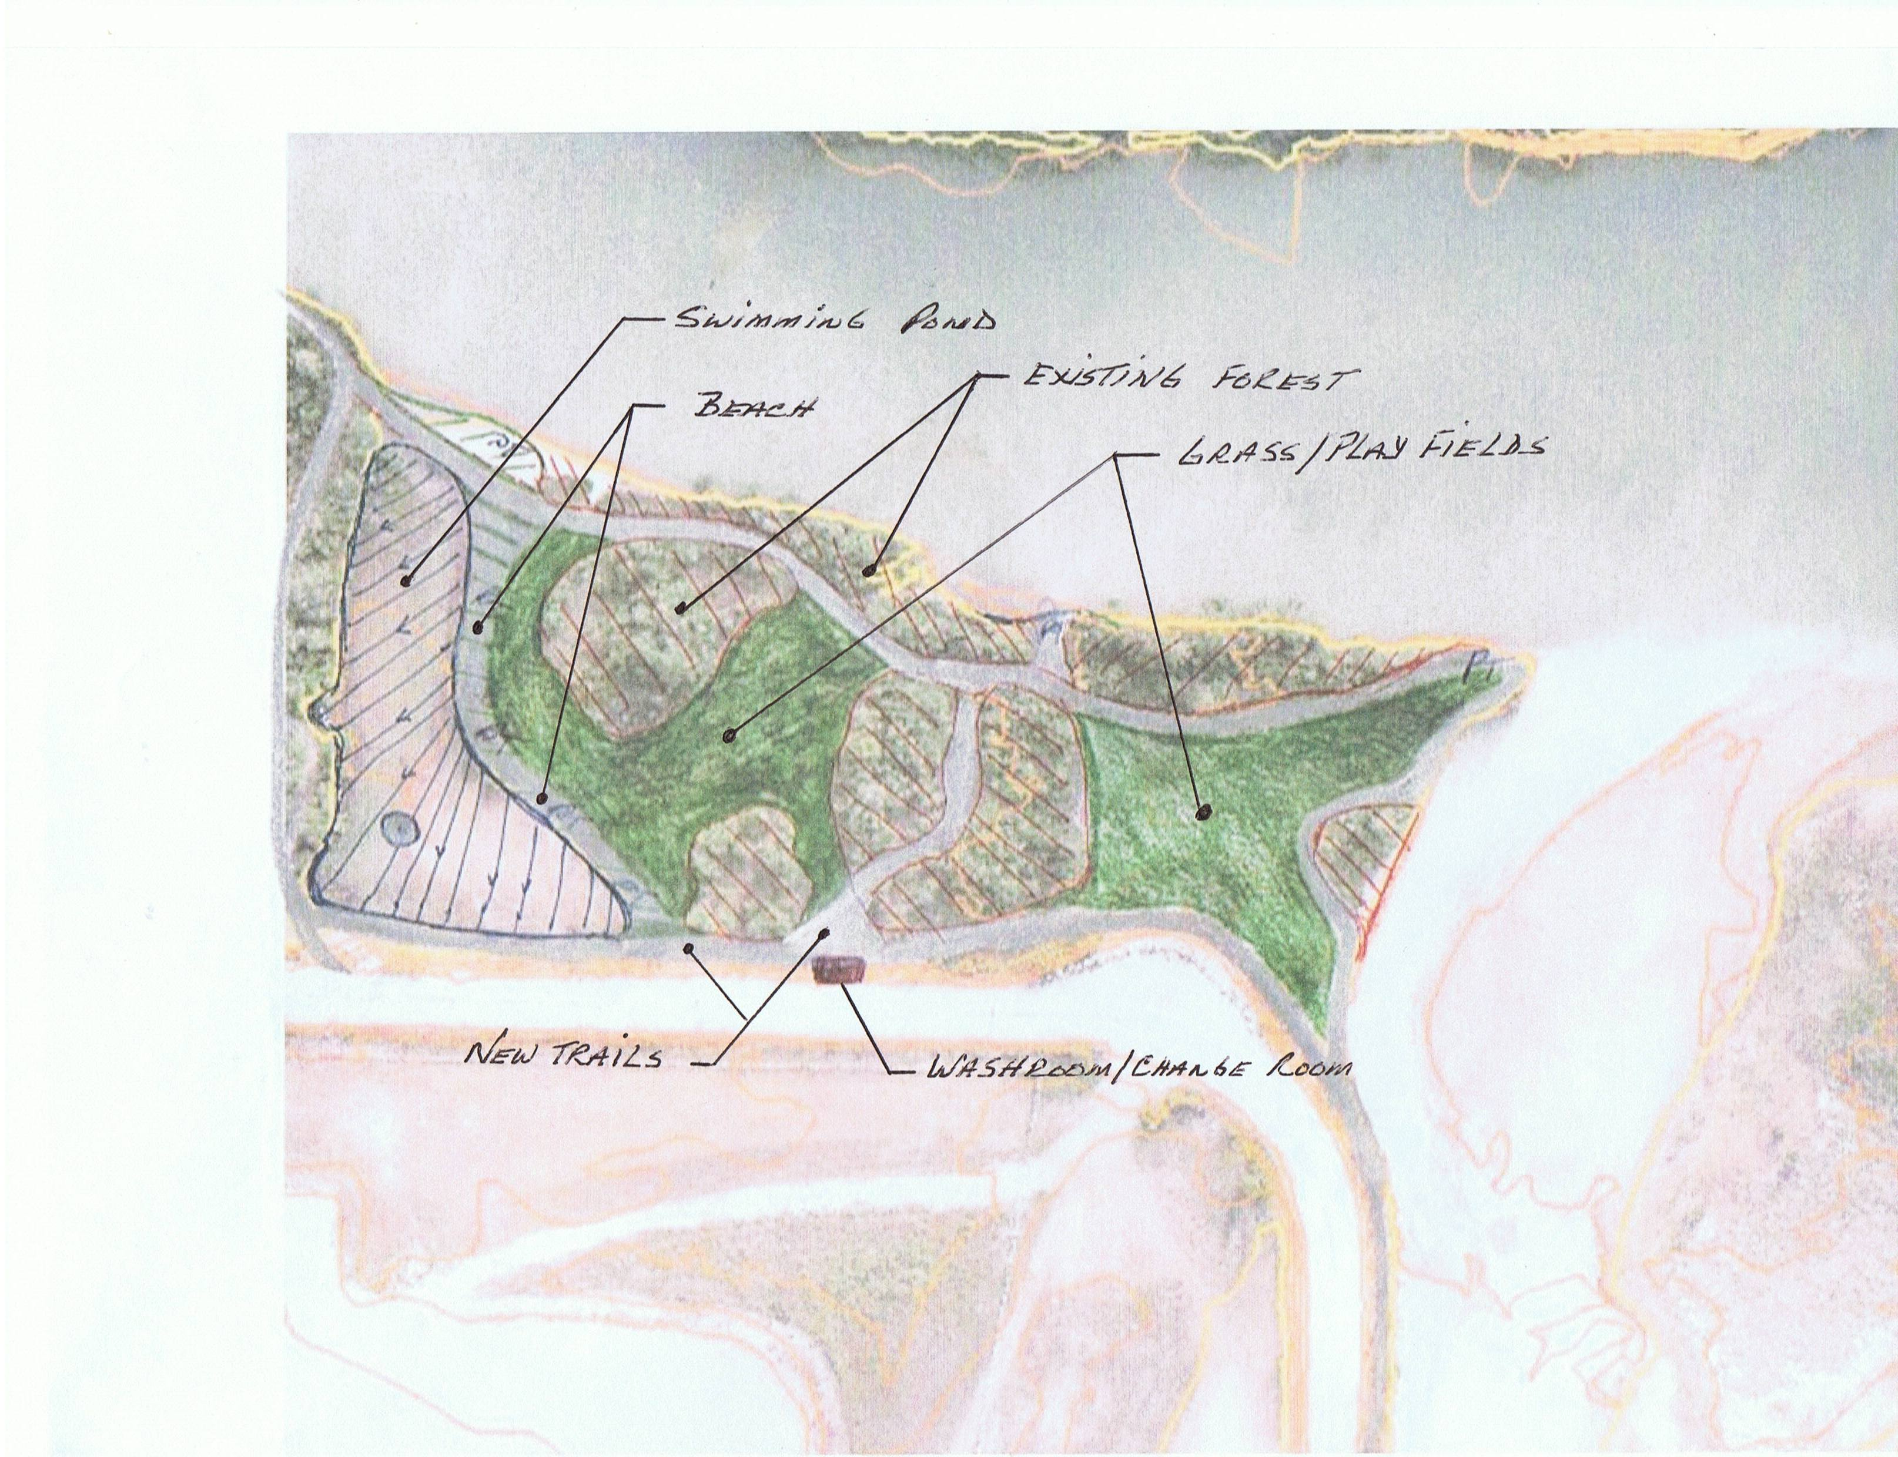
CONFLUENCE PARK TRAIL IMPROVEMENT PROJECT

Slide 16
CONFLUENCE PARK TRAIL IMPROVEMENT PROJECT PROPOSAL

Slide 17
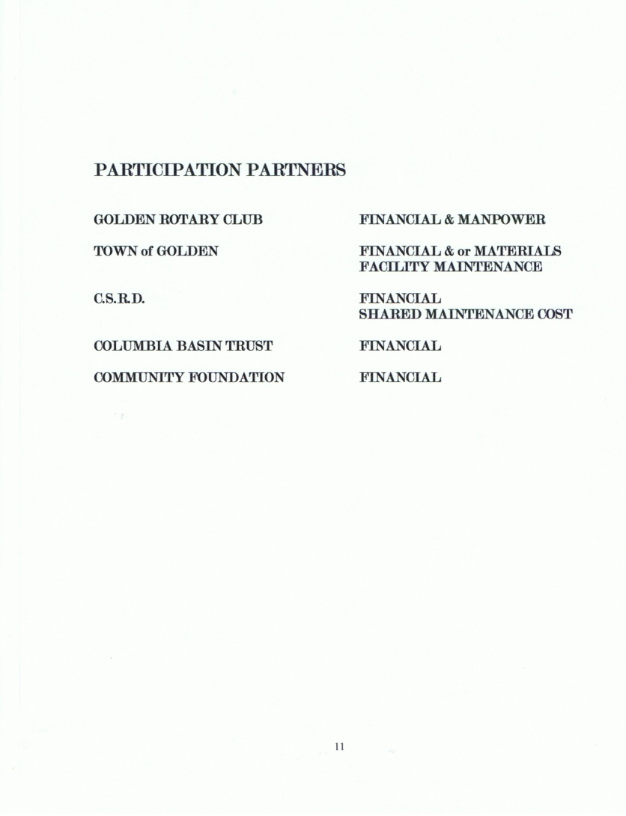
CONFLUENCE PARK TRAIL IMPROVEMENT PROJECT

Slide 18
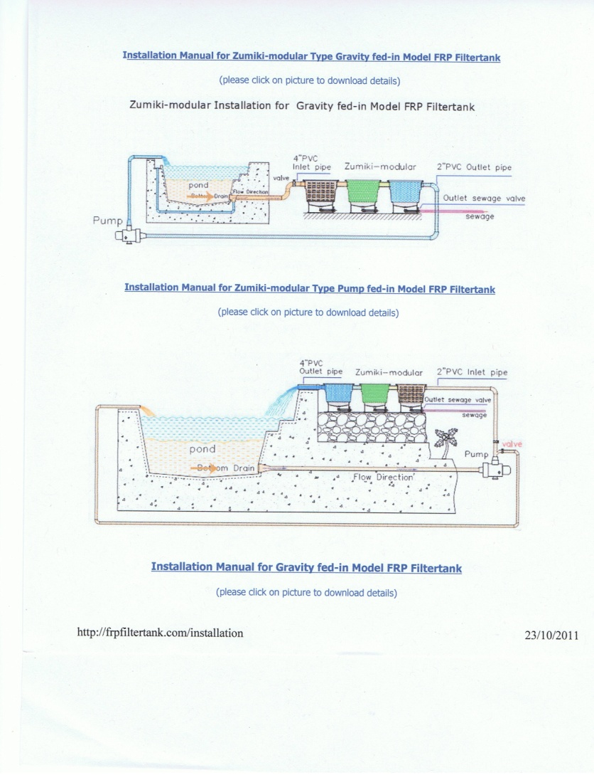
CONFLUENCE PARK TRAIL IMPROVEMENT PROJECT
FILTERTATION SYSTEM

